Slide 1


IBM Data Science
Final Project

Slide 2
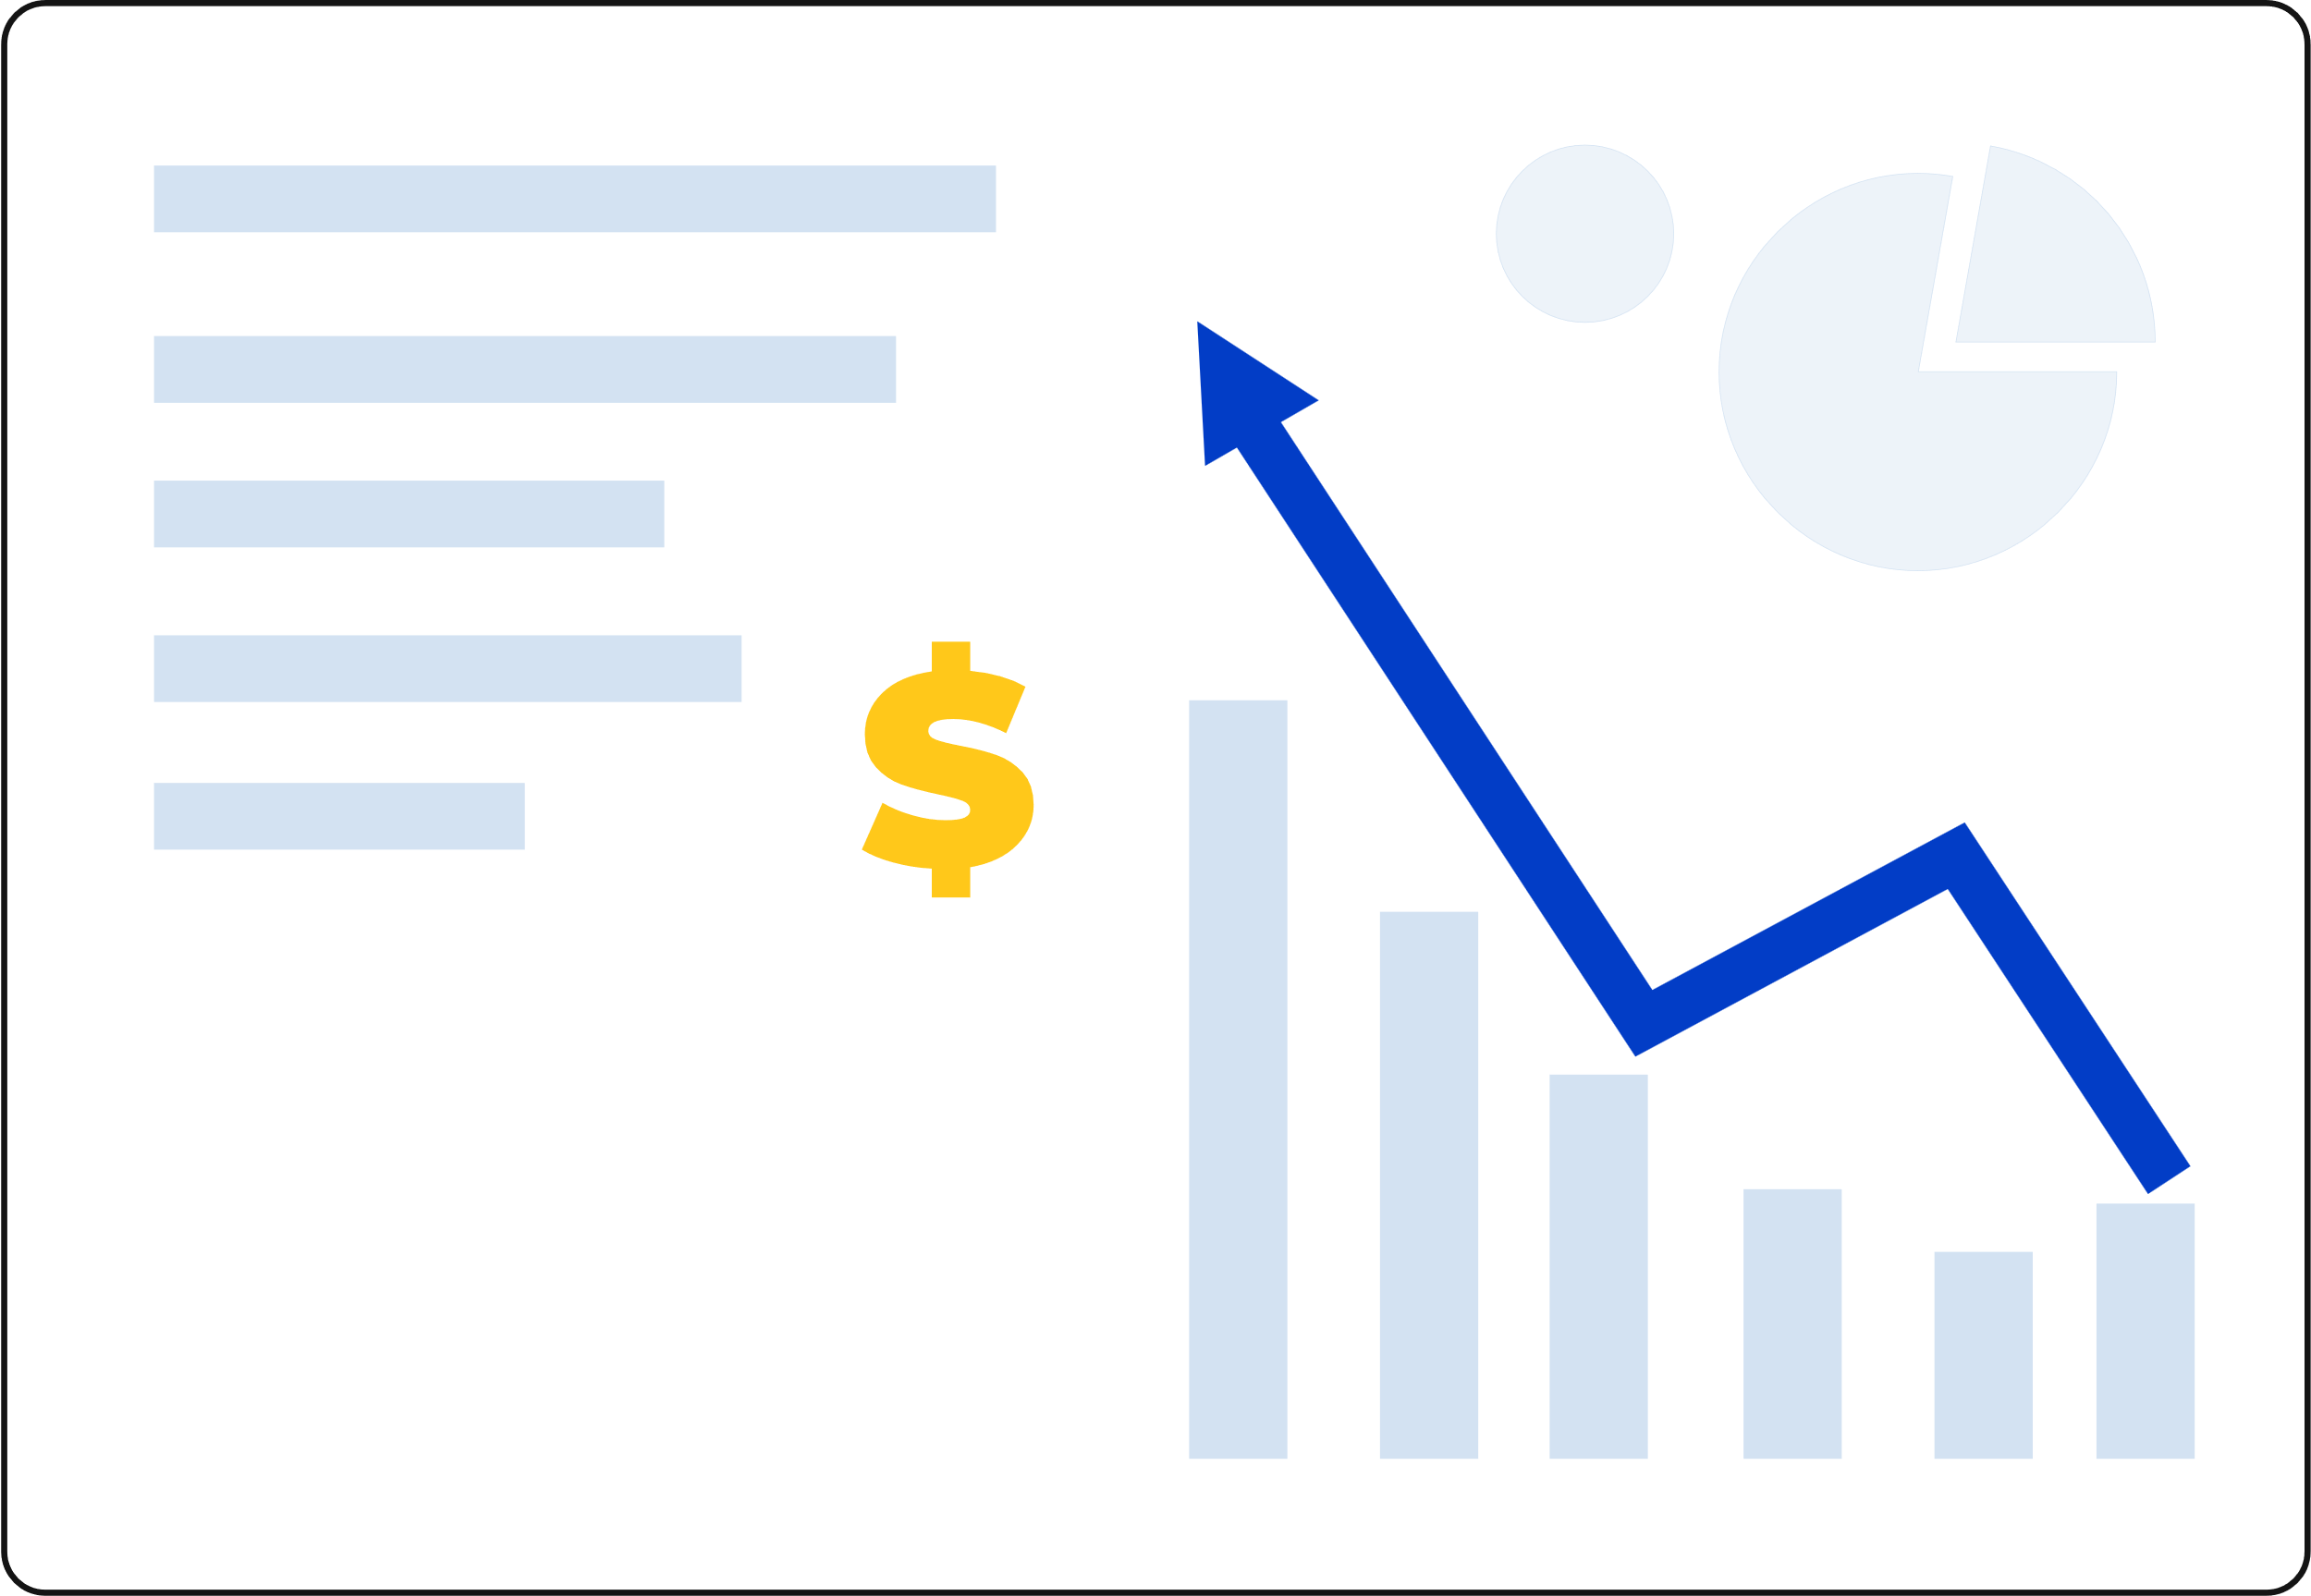
What is Data Science
Data science combines math and statistics, specialized programming, advanced analytics, artificial intelligence (AI) and machine learning with specific subject matter expertise to uncover actionable insights hidden in an organization’s data. These insights can be used to guide decision making and strategic planning.

Slide 3
Applications of Data Science
-Retail and Supply Chain Optimization
-Marketing Analytics
-Social Media Analytics
-Sports Analytics
-Climate Science and Weather Forecasting
-Healthcare and Medical Diagnosis
-Fraud Detection in Finance
-Recommendation Systems
-Natural Language Processing and Chatbots
-Autonomous Vehicles

Slide 4
Our Project
Primary Point of Contact:
Medical representatives serve as the crucial link between pharmaceutical companies and healthcare professionals, such as doctors, nurses, and pharmacists.
Key Responsibilities:
-Promote and sell pharmaceutical products, including drugs and medical equipment.
-Increase product awareness among healthcare professionals.
-Answer questions and provide information about their company’s products.
-Generate demand for their company's products through regular interactions with healthcare professionals.

Slide 5
What we used
Hardware
Software
- Python (with libraries such as Pandas, NumPy, Scikit-learn)
- Jupyter Notebook for coding and documentation
- Laptops

Slide 6
Phases
2
Data Cleaning and Preprocessing
5
Model Selection and Implementation
1
Data Collection and Exploration
3
Data Analysis and Visualization
4
Data Transformation and Preparation
6
Model Evaluation and Optimization

Slide 7

Data Collection and Exploration
Collect the data
Perform initial data exploration
Calculate basic statistics

Slide 8
Data Cleaning and Preprocessing
Clean the dataset
Use techniques such as imputation for missing values (e.g., mean, median, mode)
Transform the data into a suitable format for analysis

Slide 9
Data Analysis and Visualization
Analyze the data to find hidden relations between the data (e.g., correlation)
Visualizing the data to see the patterns and relations between the data by creating statistical plots (e.g., bar charts, histograms, scatter plots)

Slide 10
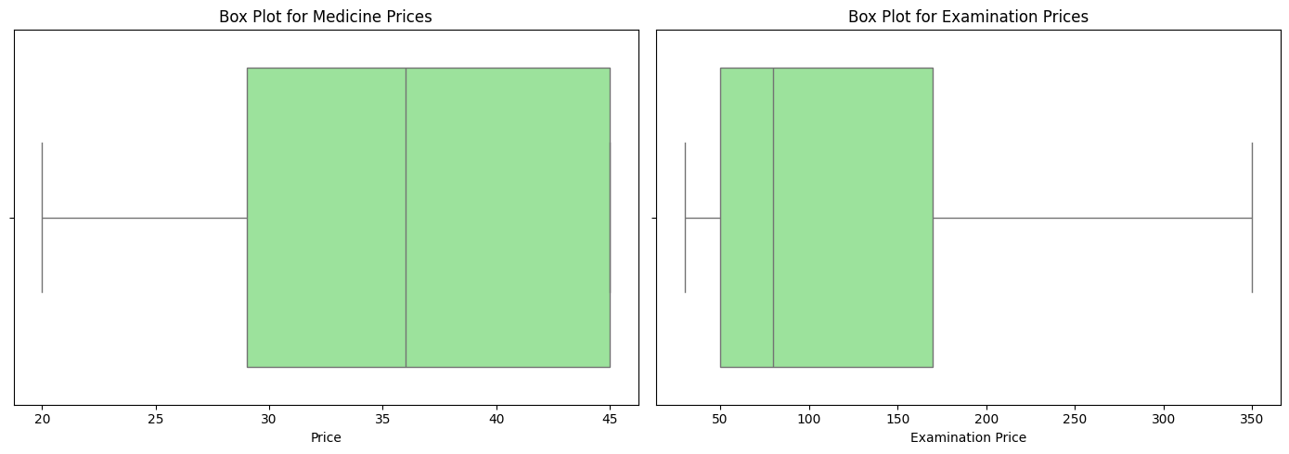

Slide 11
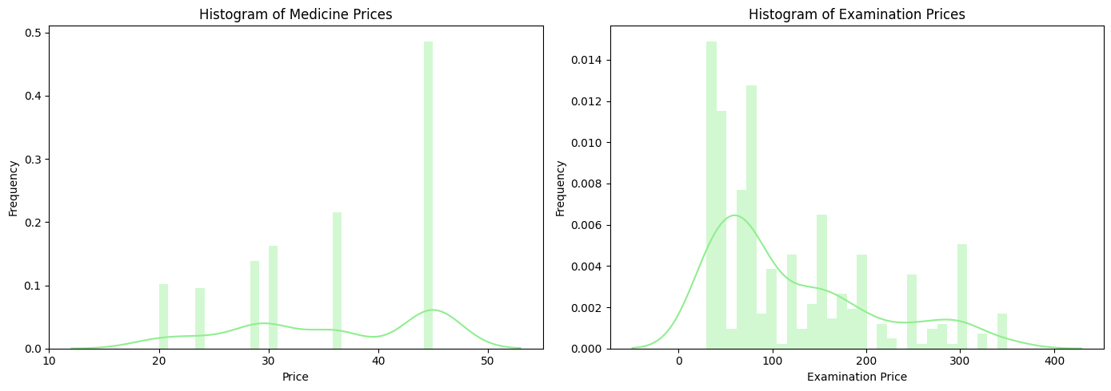

Slide 12
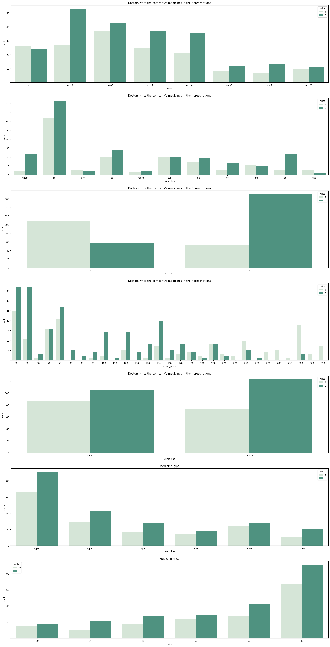

Slide 14
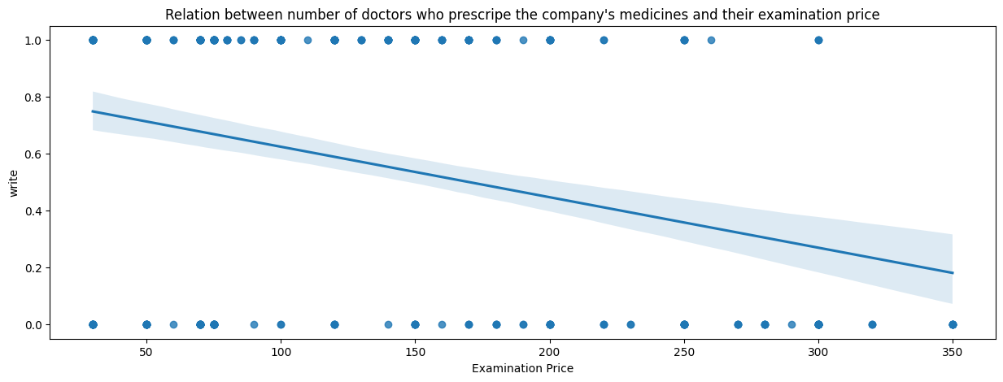

Slide 15
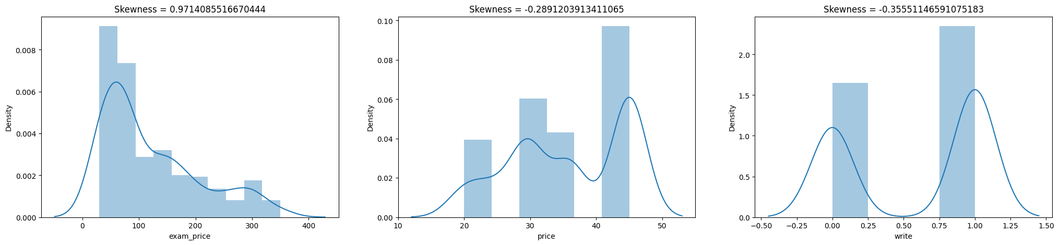

Slide 16
Data Transformation and Preparation
Transform the data into a suitable format for machine learning stage
Encoding categorical variables
Spilt the dataset into training set and testing set for model training and testing

Slide 17
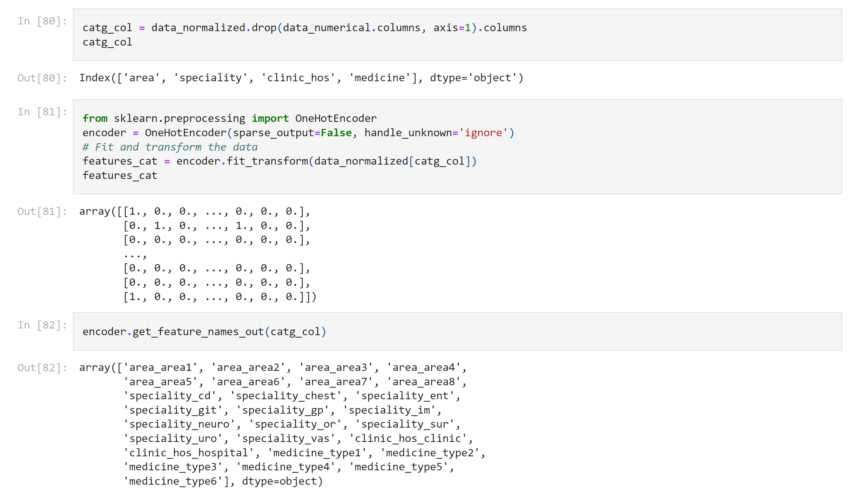

Slide 18
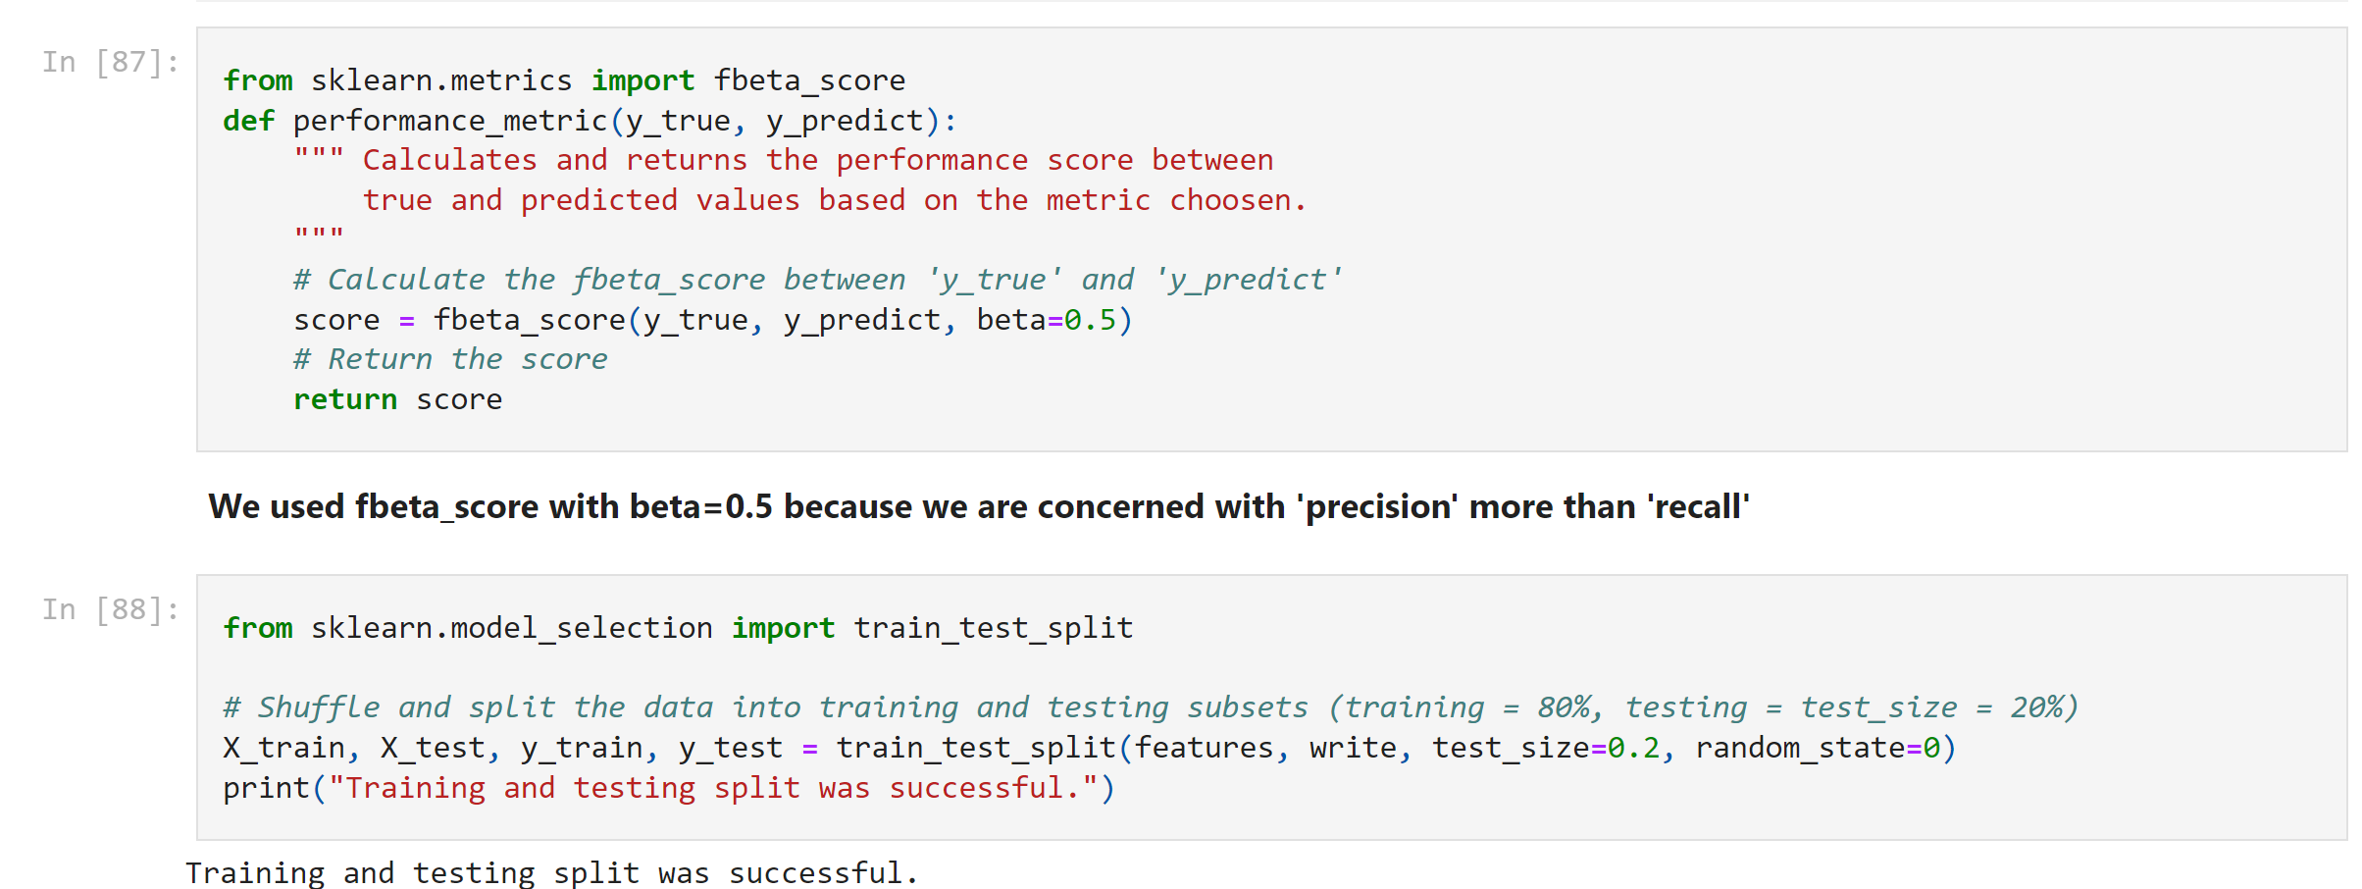

Slide 19
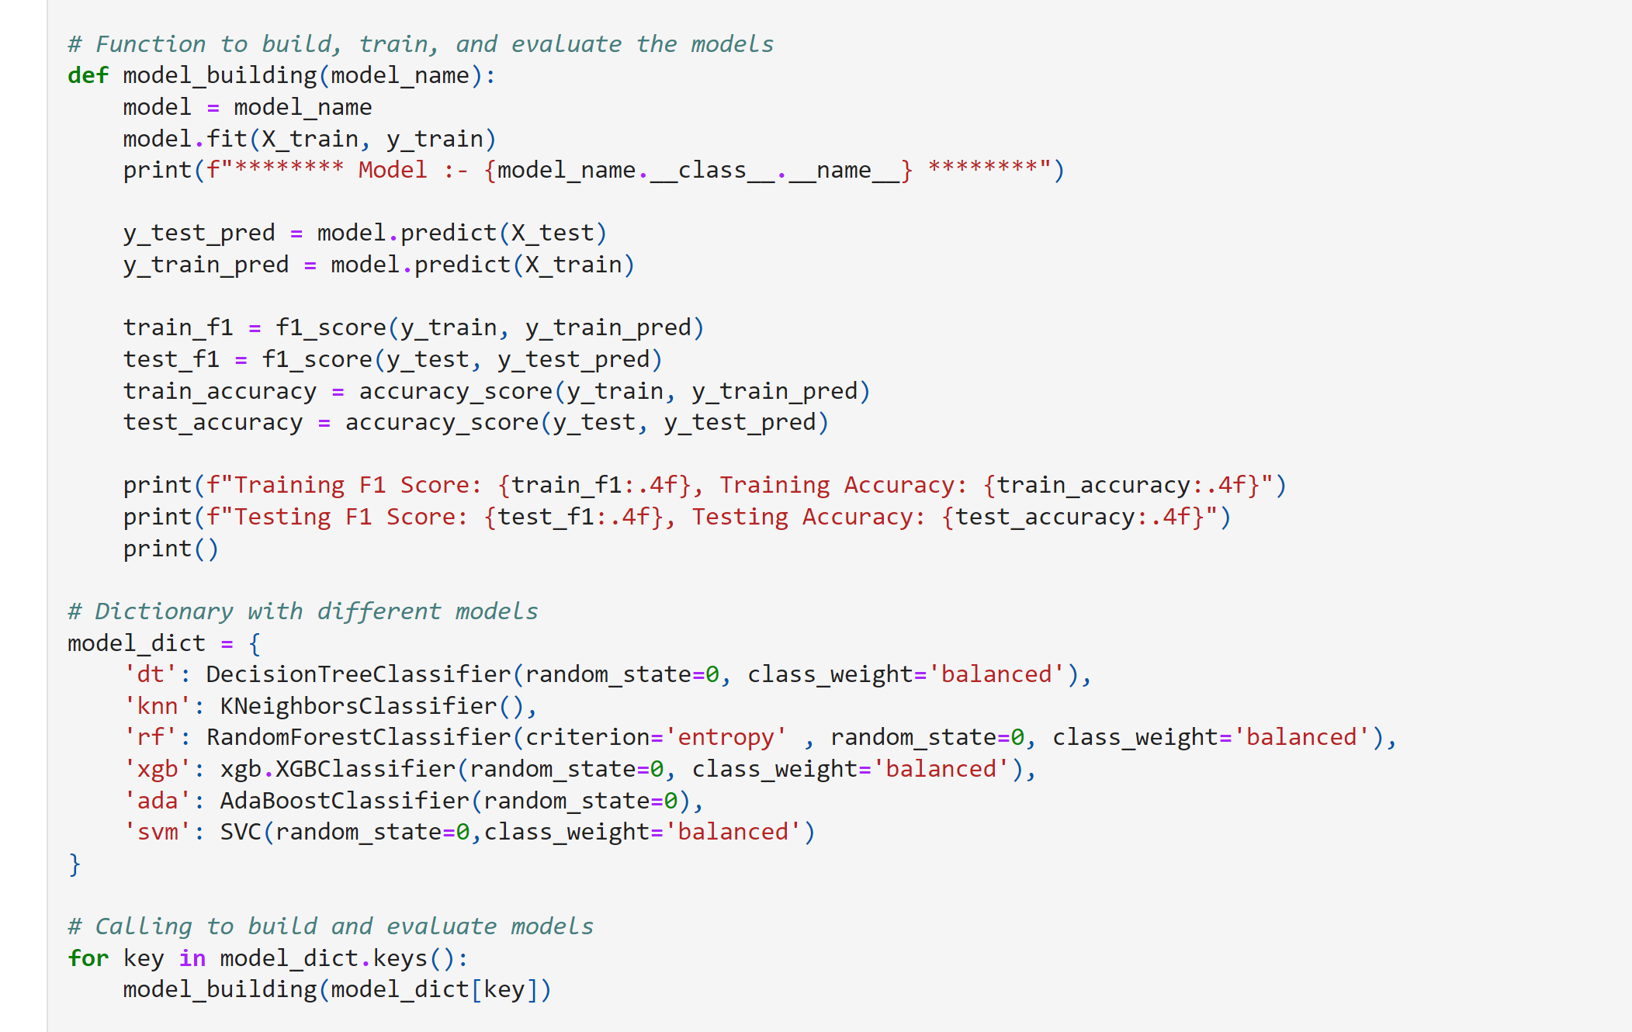

Slide 20
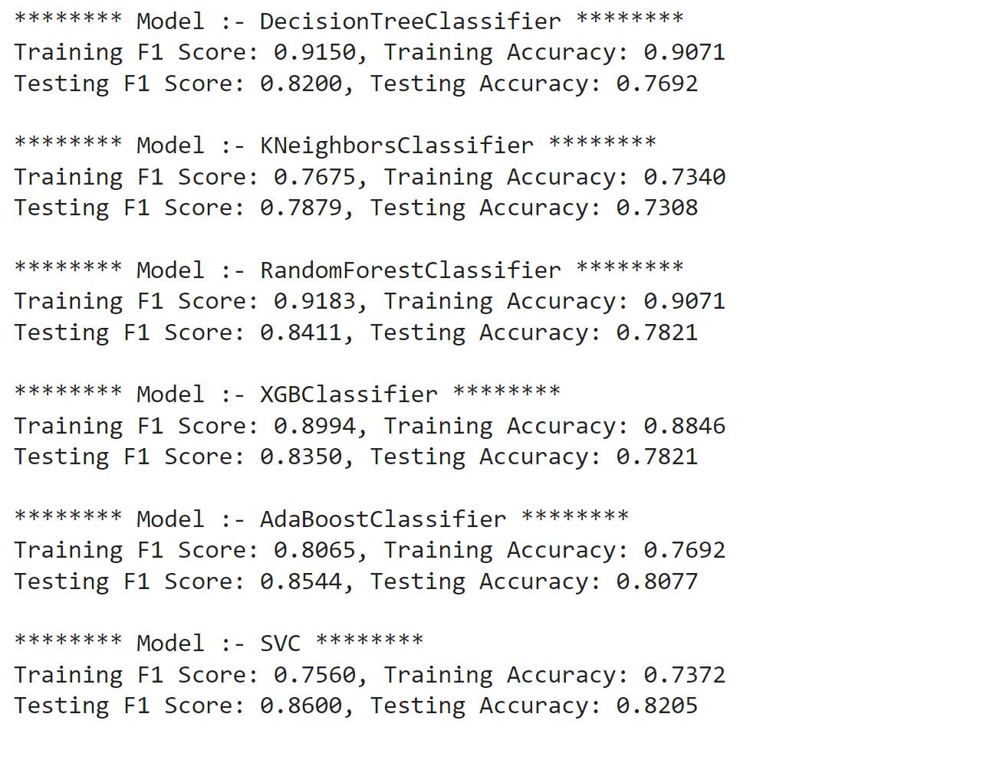

Slide 21
Model Selection and Implementation
Apply various classification models to predict whether a doctor will prescribe one of the six drugs
Evaluate models such as decision trees, SVC, and ensample methods
Perform model validation using techniques such as cross-validation.

Slide 22
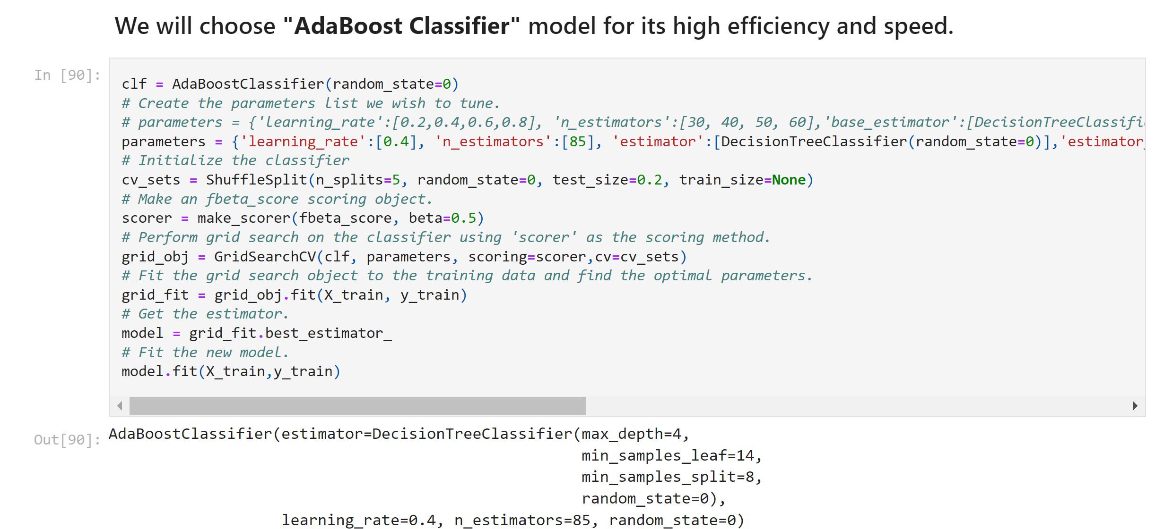

Slide 23

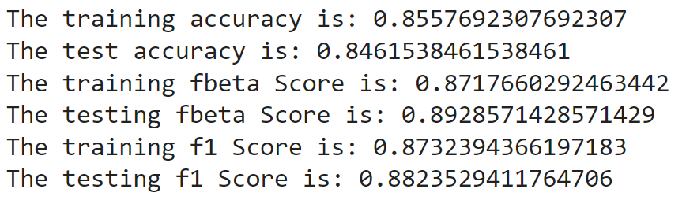

Slide 24
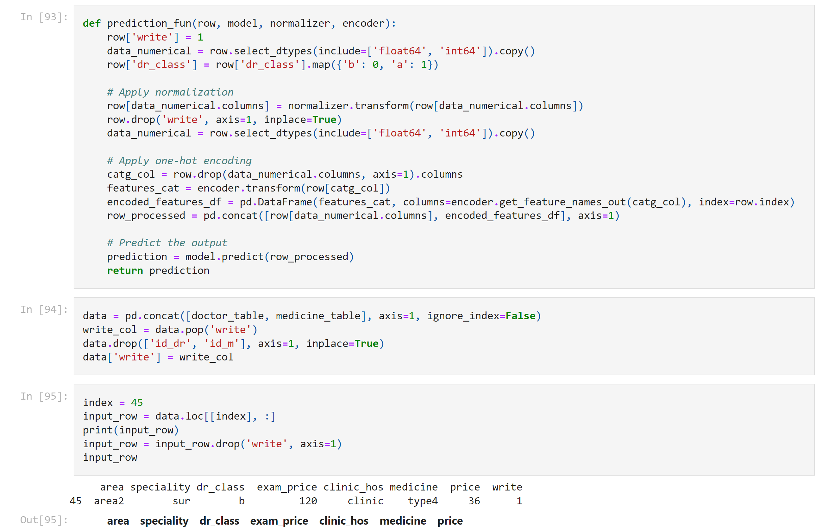

Slide 26
Model Evaluation and Optimization
Evaluate the performance of the selected models using metrics like accuracy, precision, recall, and F1-score.
Tune model parameters to optimize predictive performance.

Slide 27
Thank You

